Slide 1
Maxwell’s Thermodynamic Relations

Slide 2
Maxwell's relations are a set of equations in thermodynamics which are derivable from the symmetry of second derivatives and from the definitions of the thermodynamic potentials (U,H,F,G).
The characteristic functions are: U (internal energy), F (Helmholtz free energy), H (enthalpy), and G (Gibbs free energy). The thermodynamic parameters are: T (temperature), S (entropy), P (pressure), and V (volume).
*U,H,F,G are known as thermodynamic potentials because they play the same role in thermodynamics as the potential energy plays in mechanics

Slide 3
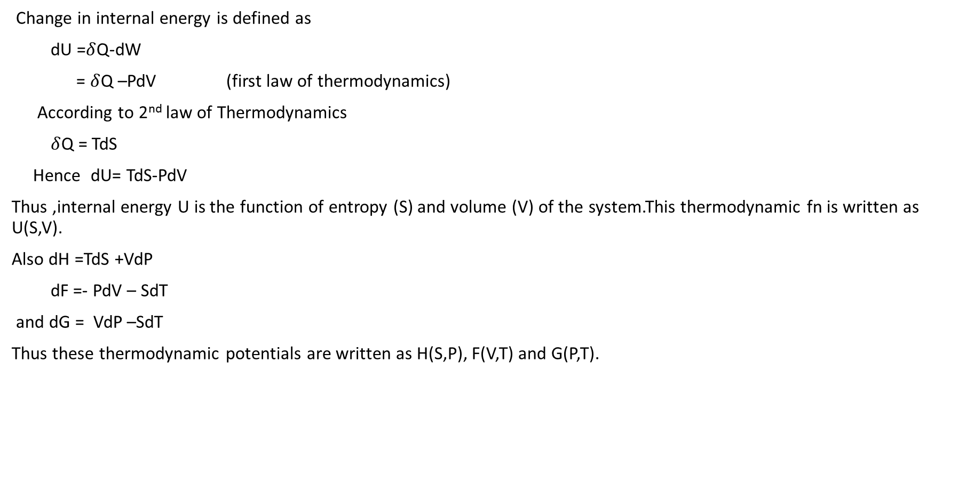
Change in internal energy is defined as
dU =$δ$Q-dW
= $δ$Q –PdV (first law of thermodynamics)
According to 2nd law of Thermodynamics
$δ$Q = TdS
Hence dU= TdS-PdV
Thus ,internal energy U is the function of entropy (S) and volume (V) of the system.This thermodynamic fn is written as U(S,V).
Also dH =TdS +VdP
dF =- PdV – SdT
and dG = VdP –SdT
Thus these thermodynamic potentials are written as H(S,P), F(V,T) and G(P,T).

Slide 4
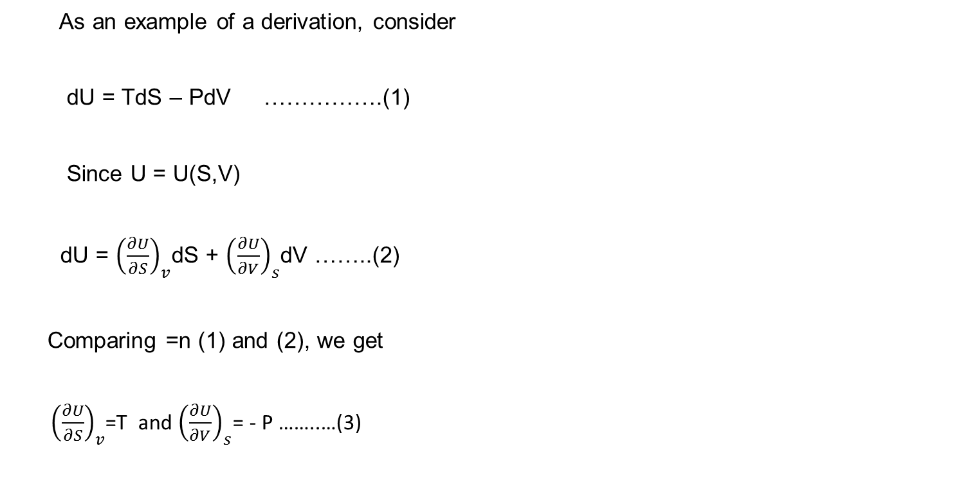
As an example of a derivation, consider
dU = TdS – PdV …………….(1)
Since U = U(S,V)
dU = ${\left(\frac{∂U}{∂S}\right)}_{v}$dS + ${\left(\frac{∂U}{∂V}\right)}_{s}$dV ……..(2)
Comparing =n (1) and (2), we get
${ \left(\frac{∂U}{∂S}\right)}_{v}$=T and ${\left(\frac{∂U}{∂V}\right)}_{s}$= - P ……..…(3)

Slide 5
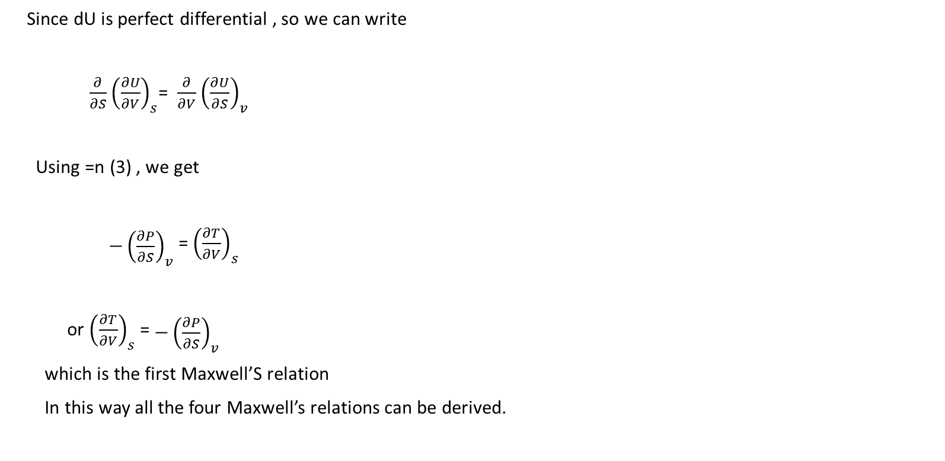
Since dU is perfect differential , so we can write
$\frac{∂}{∂S}{ \left(\frac{∂U}{∂V}\right)}_{s}$= $\frac{∂}{∂V}{ \left(\frac{∂U}{∂S}\right)}_{v}$
Using =n (3) , we get
${\begin{aligned} \\ −\left(\frac{∂P}{∂S}\right)\end{aligned}}_{v}$ = ${\left(\frac{∂T}{∂V}\right)}_{s}$
or ${\left(\frac{∂T}{∂V}\right)}_{s}$ = ${\begin{aligned} \\ −\left(\frac{∂P}{∂S}\right)\end{aligned}}_{v}$
which is the first Maxwell’S relation
In this way all the four Maxwell’s relations can be derived.

Slide 6
